Slide 1


Redefining Progressive Vision

Slide 2



But for many progressive lens wearers, clarity comes with a compromise.
Modern lens materials make glasses thinner, lighter, and tougher than ever, yet they can also introduce chromatic aberration.
This subtle distortion blurs edges, creates distracting color fringes, weakens contrast, and leads to
eye strain.
“Around
65%
of progressive lenses are made from advanced materials like polycarbonate and high-index.”
* Progressive Lenses Market Global Outlook
& Forecast 2022-2027 and internal IOT data

Slide 3

The Challenge:
Why Chromatic Aberration Matters
Chromatic aberration happens when a lens fails to focus all colors to the same point.
Instead of crisp lines, wearers see blurred edges or distracting color fringes—effects that become especially pronounced in low Abbe lens materials, stronger prescriptions, and larger frames.

Slide 4
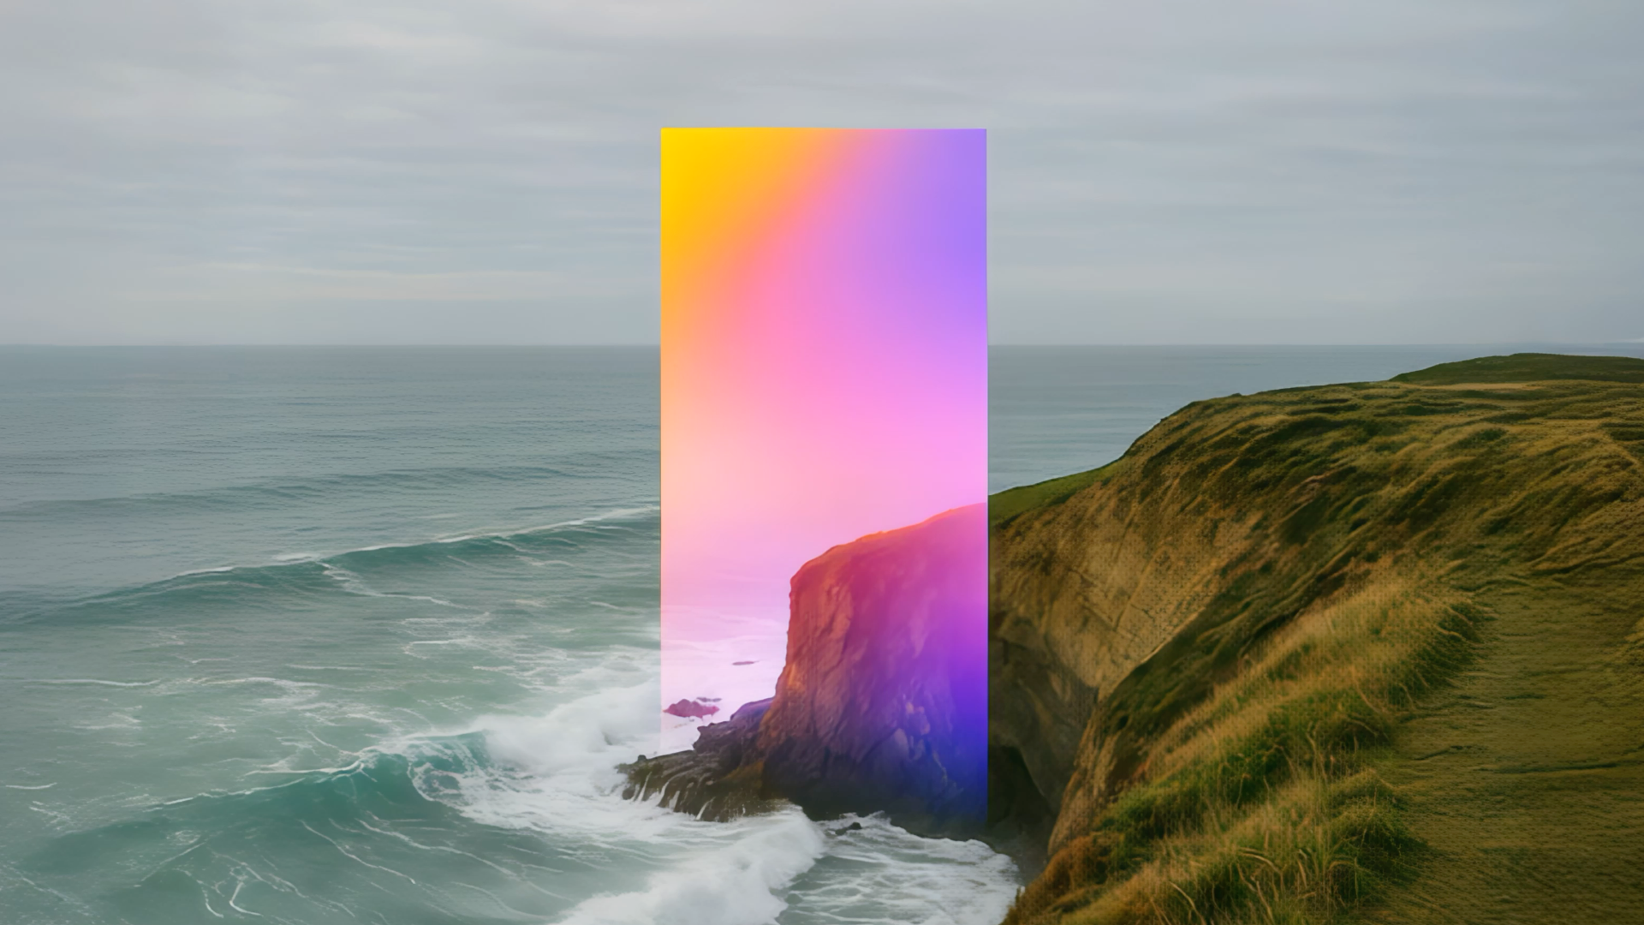
Significant Reduction in Chromatic Aberration
20%
reduction in chromatic aberration on average across all lens materials.
19%
Up to
reduction in 1.67 INDEX LENSES
18%
Up to
reduction in 1.60 INDEX LENSES

Slide 5
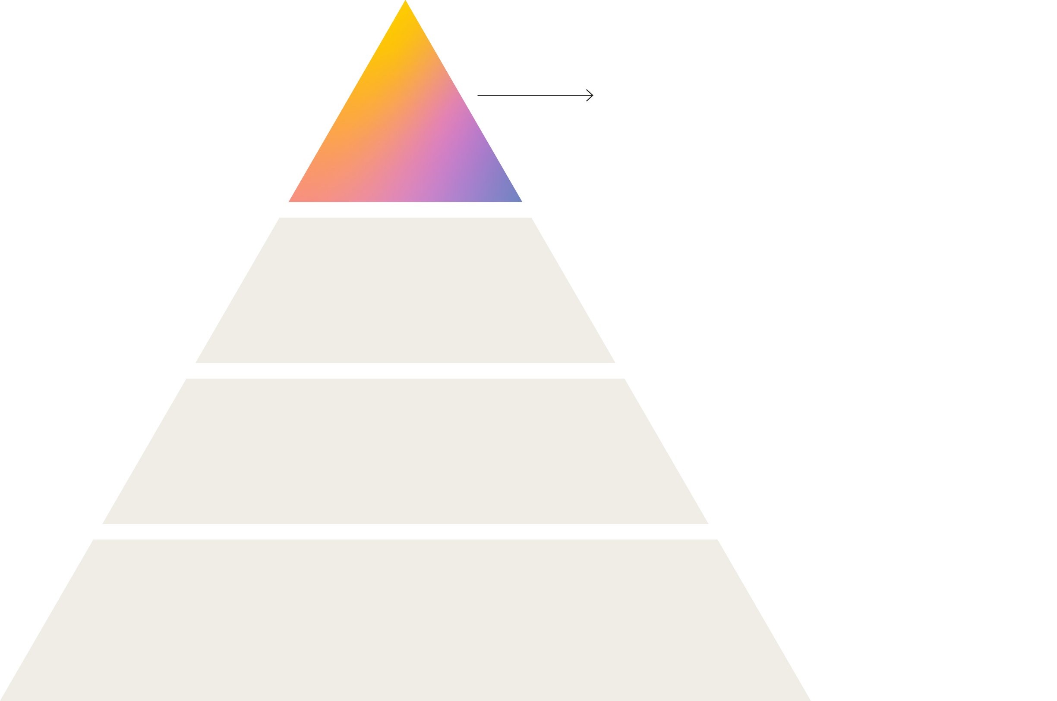
The Pinnacle
of Advanced Lens Design​
CHROMATIC
ABERRATION REDUCTION TECHNOLOGY
PATENT PENDING: US 19/340753
CamberPure unites multiple patented design and material technologies developed by IOT and Younger Optics to unlock a new level of optical performance.
Minimizes chromatic aberration for sharper, more natural vision.
POWER
OPTIMIZATION
METHODOLOGY
DIGITAL DESIGN
TECHNOLOGY
VARIABLE BASE CURVE
TECHNOLOGY

Slide 6
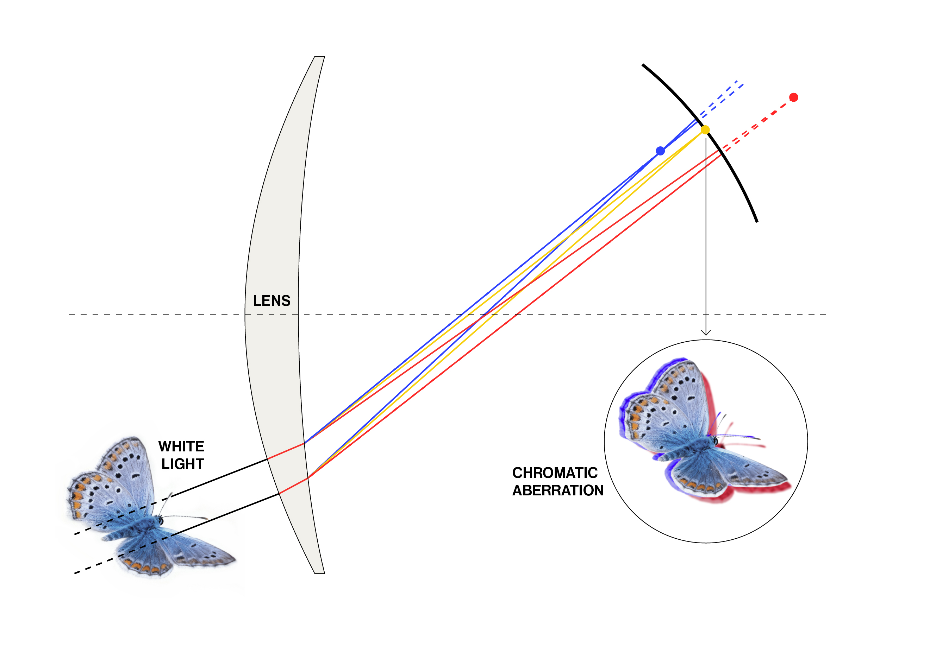
How it Works: Chromatic Aberration
Chromatic aberration is present in all lenses
Component colors of light refract differently through a lens, causing blurred edges, reduced contrast and even color fringing
Effects are especially pronounced in low Abbe lens materials, stronger prescriptions, and larger frames

Slide 7
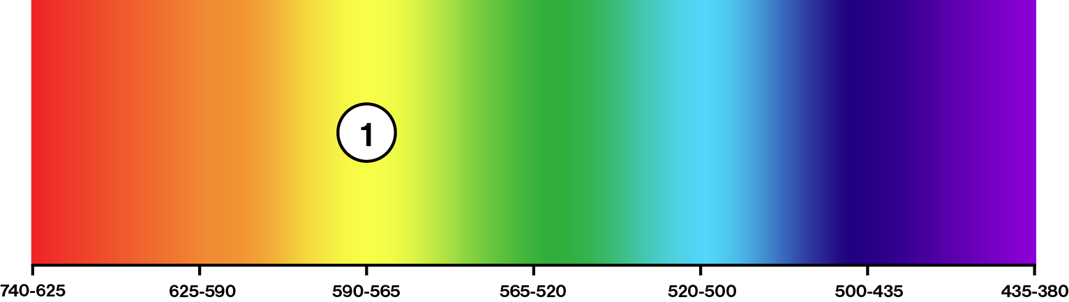
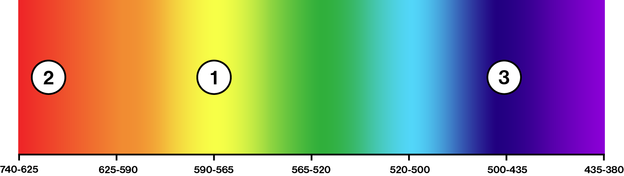
How it Works:
The CamberPure difference
Standard Lenses
Correct at only 1 bandwidth
Until now, lenses have been optimized for a single standard wavelength of yellow light (587.6 nm). The wearer experiences chromatic aberration in other parts of the visible spectrum.
CamberPure lenses are optimized for maximum color convergence across the spectrum: Yellow (d) 587.6 nm, Red (C) 656.3 nm, Blue (F) 486.1 nm, bringing the colors closer together and into sharper, more precise focus.
WAVELENGTH (NANOMETER)
CamberPure
Corrects at 3 to encompass the entire visual spectrum
WAVELENGTH (NANOMETER)
Notes:
!

Slide 8
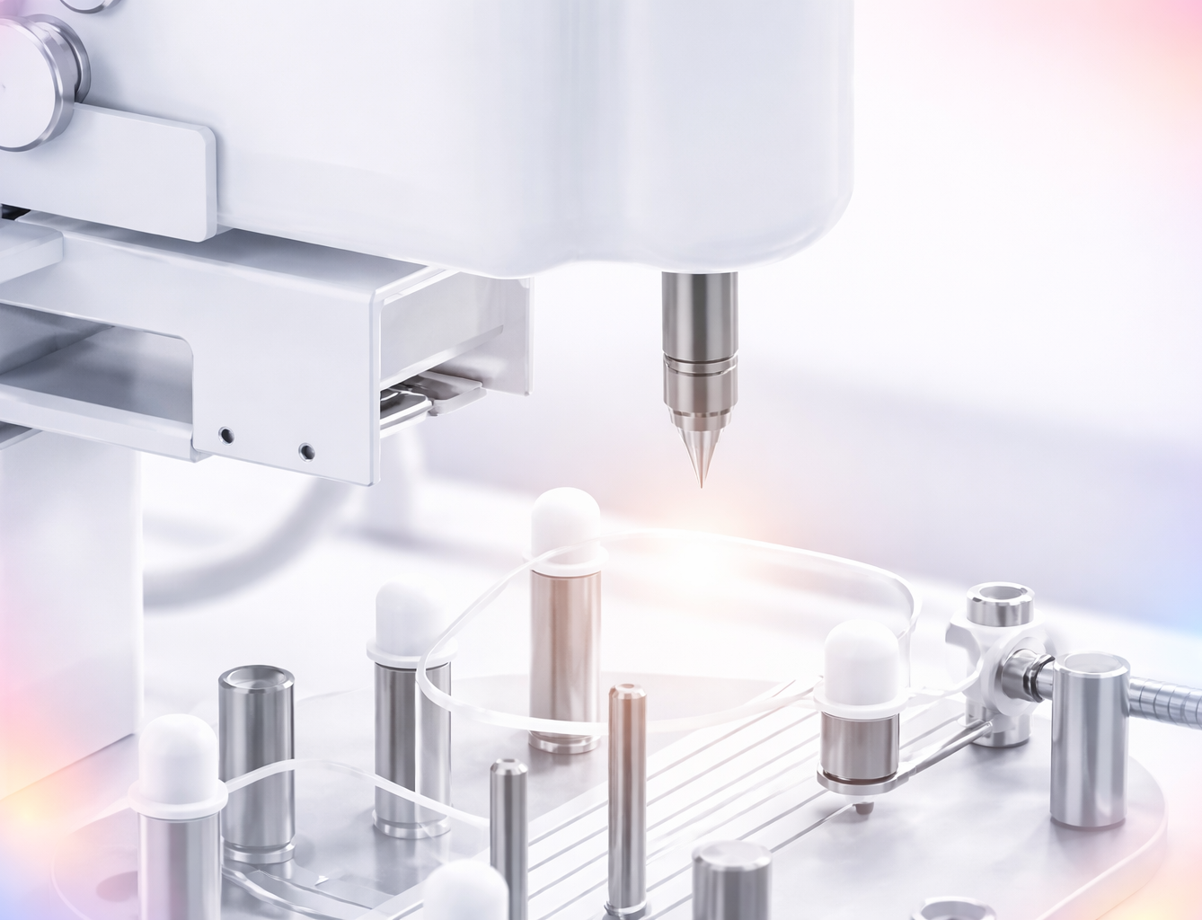
How does CamberPure achieve this?
CamberPure reduces chromatic aberration by altering the lens geometry using free-form technology. The back surface design not only reduces oblique aberrations away from the optical center – it also reduces prism at the periphery.
The lower levels of chromatic aberration achieved by CamberPure are equivalent to using a material with a higher effective Abbe value.

Slide 9

Improved Optics in All Materials
LENS MATERIALS | ABBE VALUE | Effective ABBE VALUE WITH CamberPure
Polycarbonate | 30 |  ~41
1.67/1.74 | 33 |  ~41
1.60 | 43 |  ~52
Trivex | 45 |  ~56
Hard Resin | 58 |  ~69
CamberPure unlocks the potential for significantly enhanced Abbe value performance using existing lens materials—pushing the boundaries of optical performance further than ever before.
The data presented is based on mathematical hypotheses and theoretical models. It is not guaranteed to reflect real-world results and should be used for informational purposes only.

Slide 10
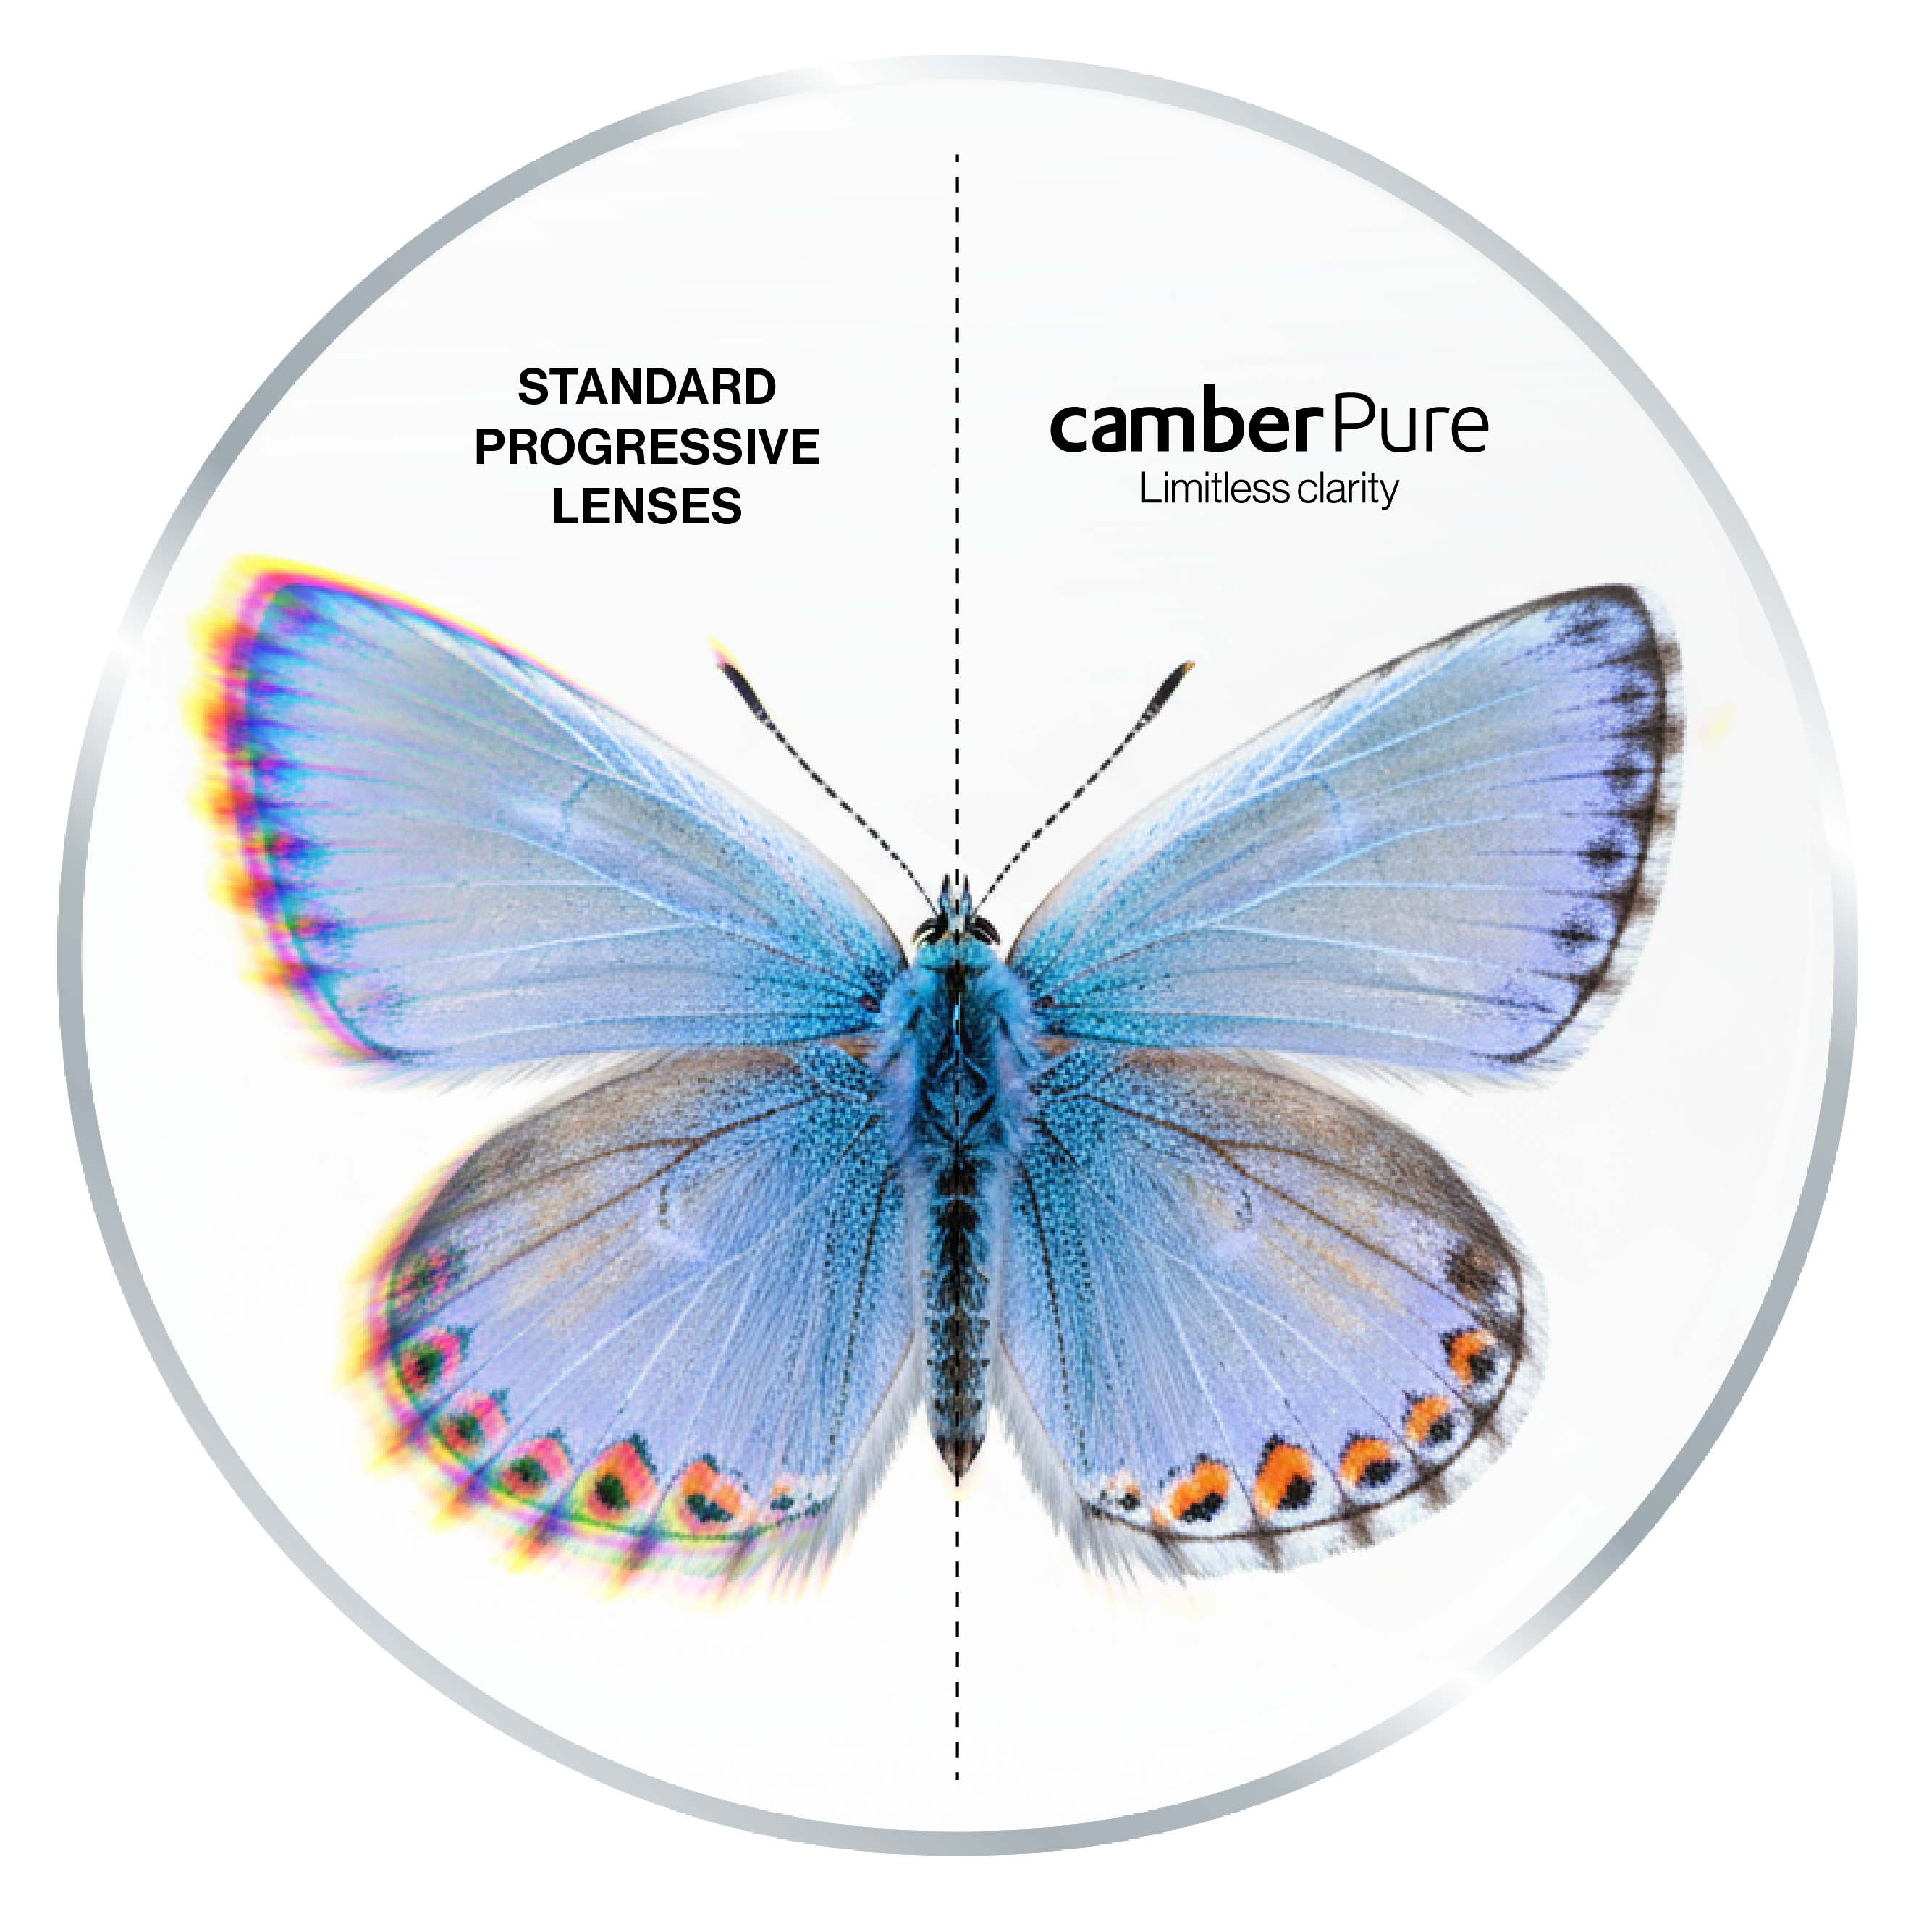
A New Level of Optical Performance
CamberPure doesn’t just correct vision; it transforms it.
Every glance brings sharp lines, pinpoint detail, and maximum contrast. Halos and blur dissipate; eyes relax. The effect is pure clarity, all day, every day.
*an artist’s interpretation of chromatic aberration

Slide 11


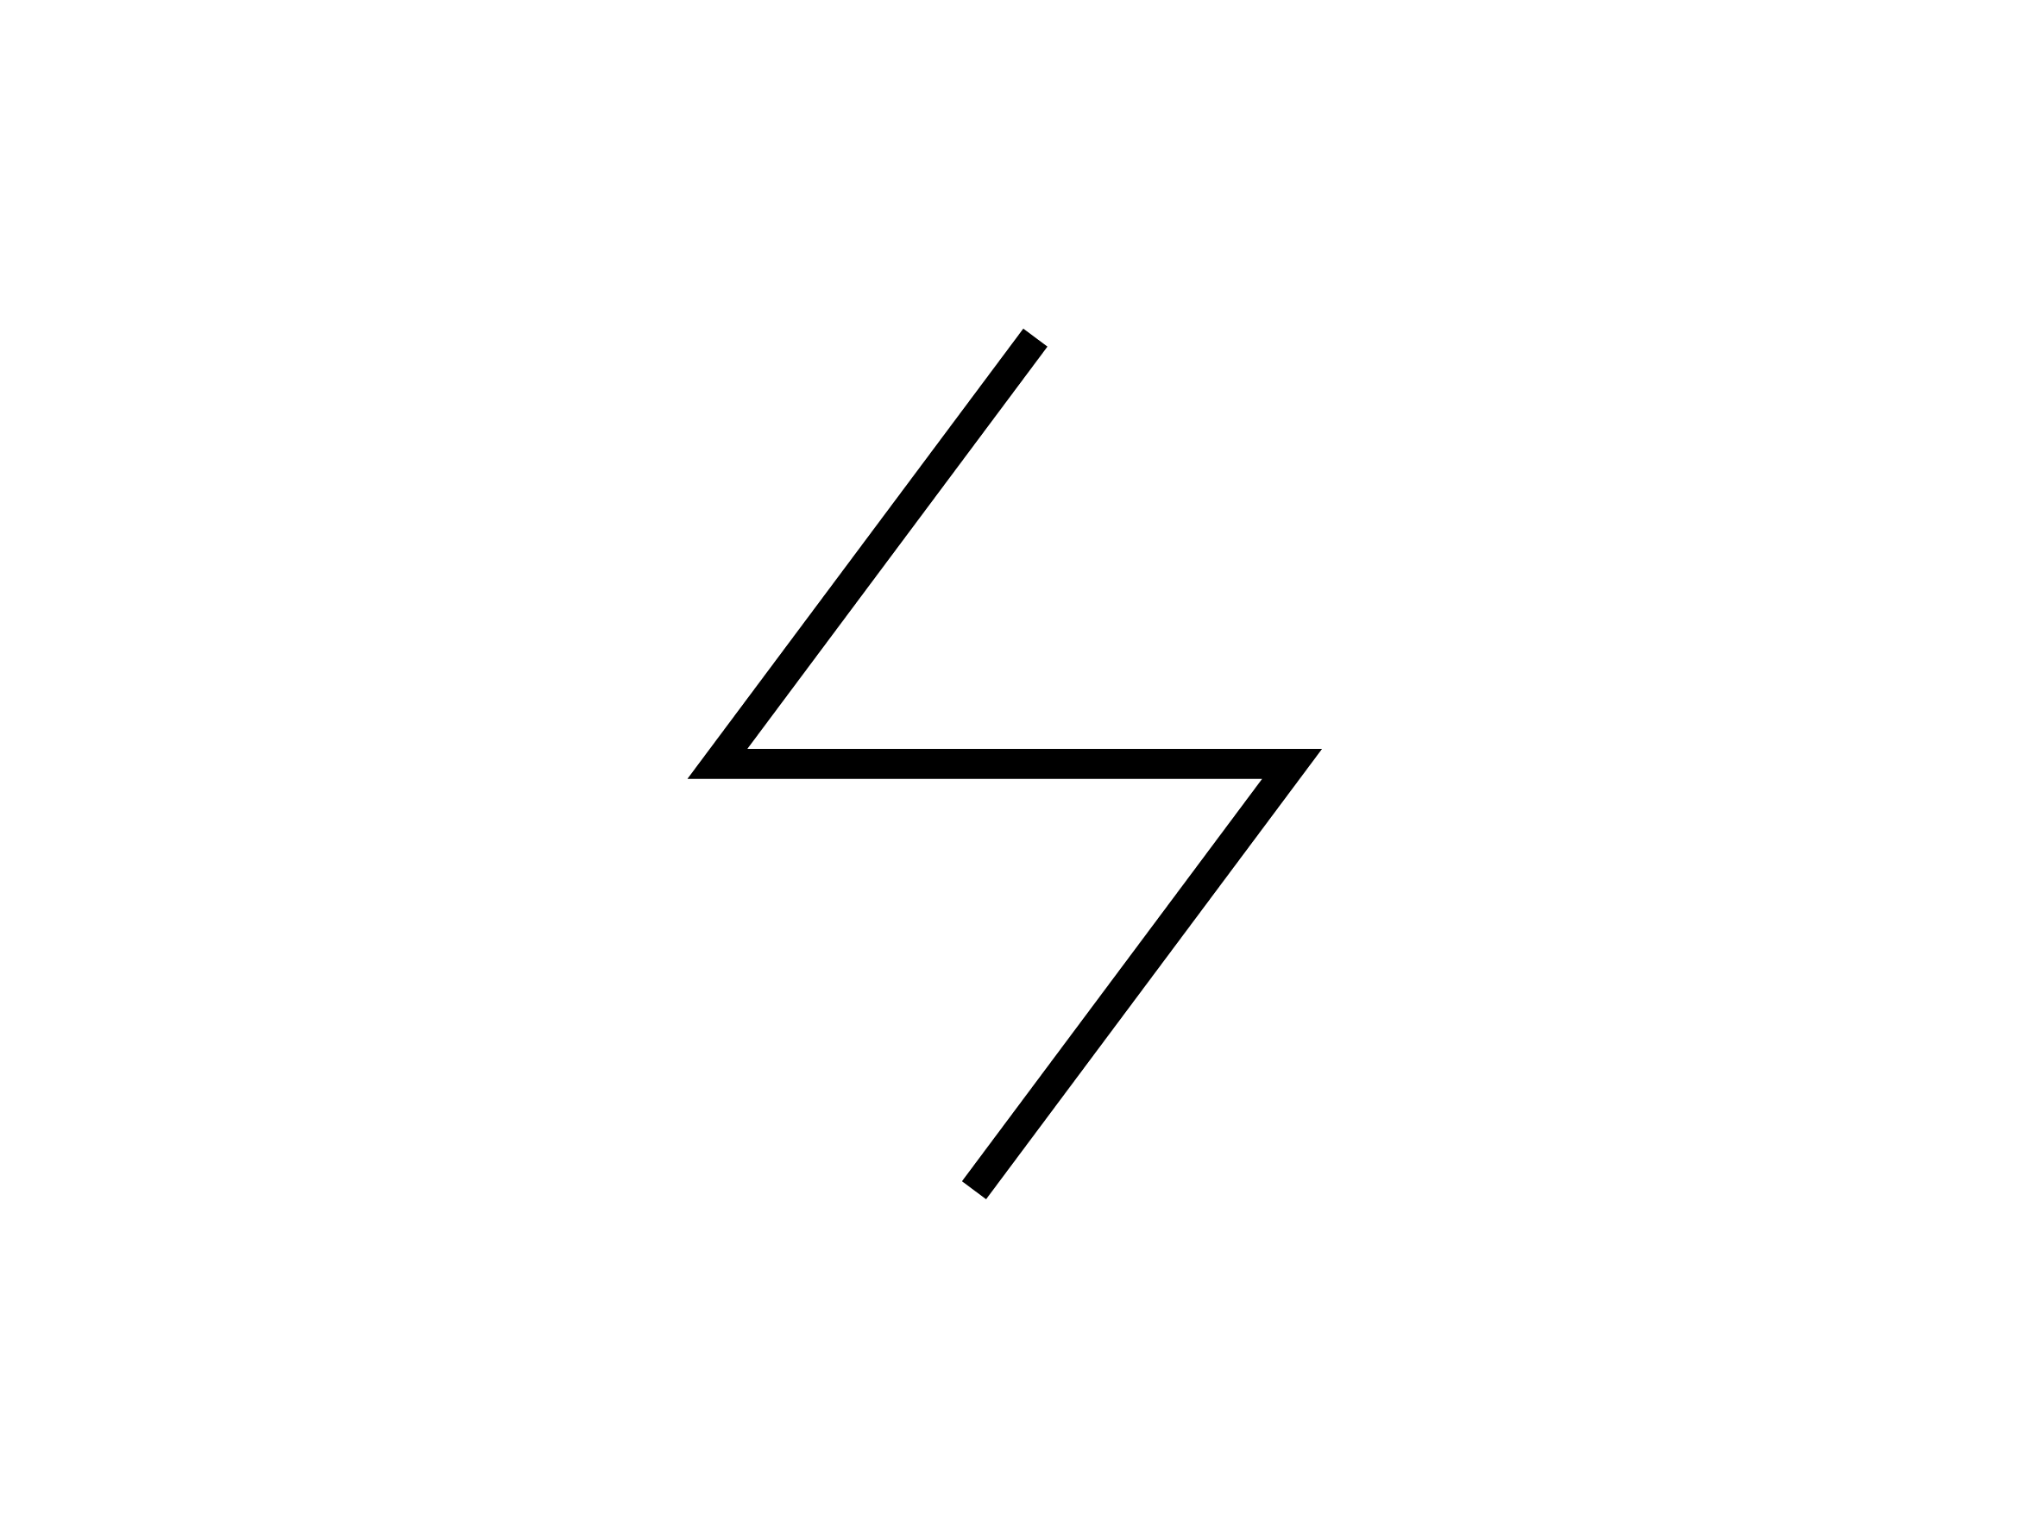



Benefits for Wearers:
Clarity in Every Moment
SHARPER, MORE ACCURATE VISION
NATURAL COLOR & CONTRAST PERCEPTION
EFFORTLESS & FASTER ADAPTATION
Crisp detail at every distance and in every direction.
Vivid, true-to-life colors with enhanced contrast sensitivity.
Smooth transitions between zones and faster adaptation.
SUPERIOR COMFORT FOR ALL-DAY WEAR
LIGHTWEIGHT, STYLISH DESIGN
Minimizes eye strain and visual fatigue, even during prolonged screen use.
Thin lenses that deliver clarity and lasting comfort.

Slide 12
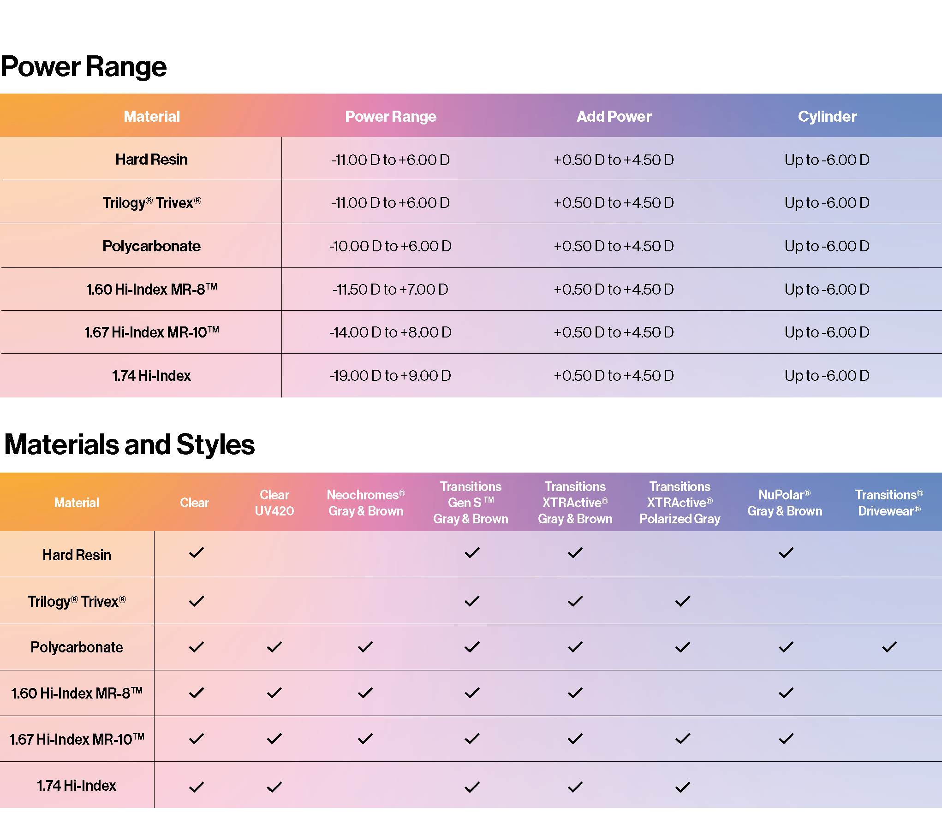
Availability
Utilizes the Camber Lens Blank
Open format for coatings
2 photochromic options
Rx from +9.00 to -19.00, up to +4.50 add
Broad material availability
1.50
Trivex
Polycarbonate
1.60
1.67
1.74

Slide 13



DEVELOPED BY LEADERS IN LENS
MATERIAL AND DESIGN INNOVATION​

Slide 14


Slide 15
A New Level of Optical Performance!
DEVELOPED BY LEADERS IN LENS
MATERIAL AND DESIGN INNOVATION​

